Slide 1
De Gruyter Databases 2023

Slide 2
Contents
Subject | TITLE
Architecture and Design | Building Types Online
Arts | Artists of the World
Classical and Ancient Near Eastern Studies | Bibliotheca Teubneriana Latina Online
Classical and Ancient Near Eastern Studies | Byzantinische Bibliographie Online
Classical and Ancient Near Eastern Studies | Thesaurus Linguae Latinae (TLL) Online
Classical and Ancient Near Eastern Studies | Wörterbuch Altgriechisch-Deutsch Online
History | Akten der Partei-Kanzlei der NSDAP
History | Biographische Handbücher der deutschsprachigen Emigration nach 1933
History | Deutsche Geschichte im 20. Jh.: Nationalsozialismus, Holocaust, Widerstand und Exil 1933-1945 Online
History | Tagesrapporte der Gestapo Wien Online
History | Hitler. Quellen 1924-45 Online
History | Handbook Ideologies in National Socialism
History | Klemperer Online
History | Nürnberger Dokumentenkartei
History | World Biographical Index Online
History | Diensttagebuch Sievers und NS-Ahnenerbe
History | Stimmungs- und Lageberichte
History | Tarnschriften 1933 bis 1945
History | Die Tagebücher von Joseph Goebbels Online
History | Vossische Zeitung 1918-1934 Online
History | Widerstand als „Hochverrat“
Subject | TITLE
Jewish Studies | Archiv Bibliographia Judaica – Deutschsprachiges Judentum Online
Jewish Studies | Handbuch des Antisemitismus Online
Jewish Studies | Deutsch-jüdische Quellen aus Palästina / Israel
Jewish Studies | Singerman Bibliography of Antisemitic Texts in English
Linguistics and Semiotics | Enhanced Electronic Grammars Online
Linguistics and Semiotics | Wörterbücher zur Sprach- und Kommunikationswissenschaft (WSK) Online
Linguistics and Semiotics | Linguistic Minorities in Europe Online
Linguistics and Semiotics | Treasury of Linguistic Maps Online
Literary Studies | Deutsche Literatur des 18. Jahrhunderts Online
Literary Studies | Deutsches Literatur-Lexikon Online
Literary Studies | Deutsches Theater-Lexikon Online
Literary Studies | Germanische Altertumskunde Online
Literary Studies | Der literarische Expressionismus Online
Medicine | PY9999
Philosophy | Works of Philosophy and Their Reception
Theology and Religious Studies | Encyclopedia of the Bible and Its Reception Online
Theology and Religious Studies | Encyclopedia of Jewish-Christian Relations Online
Theology and Religious Studies | Tillich Online

Slide 3
De Gruyter Databases 2023 Architecture and Design

Slide 4
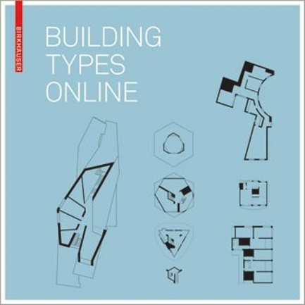
BUILDING TYPES ONLINE
In cooperation with Bauwelt
An indispensable tool for studying and teaching architecture with over 1300 entries, 6300 drawings, and 2700 photographs.
The large international collection contains contemporary buildings, from housing and offices to museums, schools and other building types.
A focus on floor plans and other architectural drawings in unrivalled quality - a considerable segment of the drawings are vector-based.
Building Types Online is a resource for the study and practice of architectural design. It is based on Birkhäuser‘s high international standing in professional architecture books, on the knowledge of the authors, who are leading experts in their fields, as well as on the technical quality of the illustrations.
Building types comprise housing with many subcategories as a focus, as well as schools and kindergartens, offices, museums and many more.
LANGUAGE English
USER INTERFACE English, German
UPDATE FREQUENCY Annually
For further information, please visit our website.
Get your free trial here.

Slide 5
De Gruyter Databases 2023 Arts

Slide 6
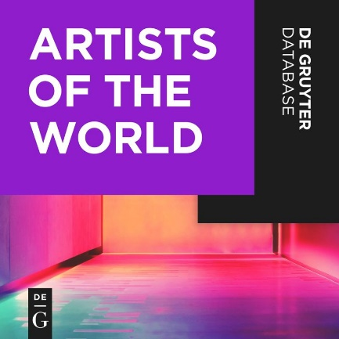
Artists of the World
[INTERNATIONALE DATENBANK BILDENDER KUNSTLERINNEN UND KUNSTLER]
More than 1.2 million editorially reviewed entries on artists and artist groups.
More than 500,000 detailed, signed biographical articles, with searchable full text.
Ongoing addition of new artists (approx. 1,000 entries per year) and updates of the.
biographical metadata and other information (approx. 3,000 changes per year).
New articles by over 8000 international experts in areas of focus (e.g. African artists, contemporary architects).
Various search and filter criteria for professional and scholarly search queries in a user-friendly interface.
Information on places of activity and artists’ networks in the form of maps and lists.
Unlimited number of simultaneous users per campus or institution.
The database Artists of the World is the world’s most current, reliable, and extensive reference work on artists. It contains authoritative, up-to-date biographical information on more than 1.2 million artists – more than any other database in the world. It
contains biographical information on artists and entries on groups of visual artists from all over the world and from all eras. It covers all genres of fine arts, painting, graphics, sculpture, architecture, photography, video, installation art, and much more.
Each biographical entry includes structural data and metadata, which, in addition to name variants with source information, provide geographical and chronological evidence. Entries with detailed articles are supplemented by lists of works, literature,
sources, and exhibitions.
Authors (selection): Arnauld Brejon de Lavergnée (Simon Vouet), Stephanie Buck (Hans Holbein), Vaughan Hart (Inigo Jones), Peter Humfrey (Tizian), Reha Günay (Sinan), Christian Spies (Pablo Picasso), Naomi Sato (Helen Schjerfbeck), Martino Stierli (Rem Koolhaas), Khanh Trinh (Goshun), Frank Zöllner (Leonardo da Vinci)
LANGUAGE OF PUBLICATION German
USER INTERFACE English, German
SUBJECT AREAS Art, art history, architectural history, photography, arts and crafts, new media
READERSHIP Art History Institutions, Museums,
Libraries, Art and Antiquities Trade, Auction houses, Collectors, Art dealers, Curators
For further information, please visit our website.
Get your free trial here.

Slide 7
De Gruyter Databases 2023 Classical and Ancient Near Eastern Studies

Slide 8
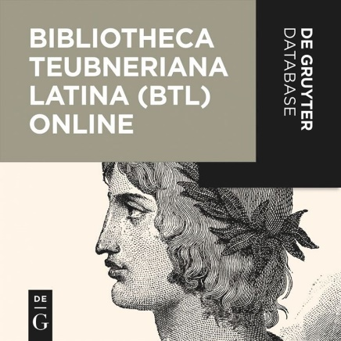
Bibliotheca Teubneriana Latina Online
Over 13 million word forms accessible electronically through the database.
Includes access to all editions of Latin texts published in the Bibliotheca Teubneriana, enhanced with De Gruyter’s signature database features.
Annual updates to our online edition ensure that the newest printed texts are available for access.
BTL and TLL are also available as a set.
Non-restrictive DRM – allows for an unlimited number of simultaneous users campus / institution-wide.
The BTL Online database provides electronic access to all editions of Latin texts published in the Bibliotheca Teubneriana, ranging from antiquity and late antiquity to medieval and neo-Latin texts. A total of approximately 13 million word forms are thus accessible electronically.
LANGUAGE Latin
USER INTERFACE English, German
UPDATE FREQUENCY Annually
For further information, please visit our website.
Get your free trial here.

Slide 9
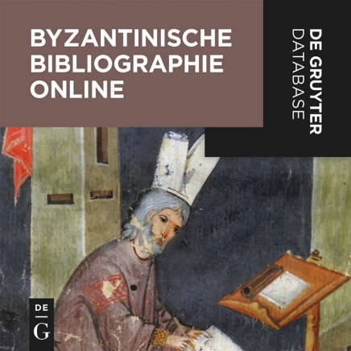
Byzantinische Bibliographie Online
The only comprehensive professional bibliography of Byzantinism, now available online.
Updated twice a year.
State-of-the-art classification.
Non-restrictive DRM – allows for unlimited simultaneous users campus / institution-wide.
The Byzantinische Bibliographie Online includes the bibliographic sections of the Byzantinische Zeitschrift from volume 98 (2005) up to the present day.
Users can either browse the bibliography by subject category and organize the results by title, author, publication year, and relevance, or do a search by (key) word, author, publication type, publication year, publisher, ISSN, and ISBN, and combinations thereof.
LANGUAGE German
USER INTERFACE English, German
UPDATE FREQUENCY Twice a year
For further information, please visit our website.
Get your free trial here.

Slide 10
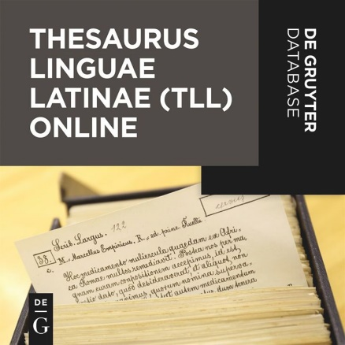
Thesaurus Linguae Latinae (TLL) Online
Content is identical to the printed version, including all lexicon articles, enhanced with De Gruyter’s signature database features.
Annual updates to our online edition ensure that the newest printed fascicles are available for access.
TLL and BTL are also available as a set.
Non-restrictive DRM – allows for an unlimited number of simultaneous users campus / institution-wide.
The Thesaurus Linguae Latinae (TLL) Online is the largest and most detailed Latin dictionary in the world. The extensive and detailed entries cover the classical period up to about 600 A.D. This encyclopedic database, based on the renowned print dictionary of the same name, is designed to serve as an ideal tool for both research and teaching preparation at university level.
LANGUAGE German
USER INTERFACE English, German
UPDATE FREQUENCY Annually
For further information, please visit our website.
Get your free trial here.

Slide 11
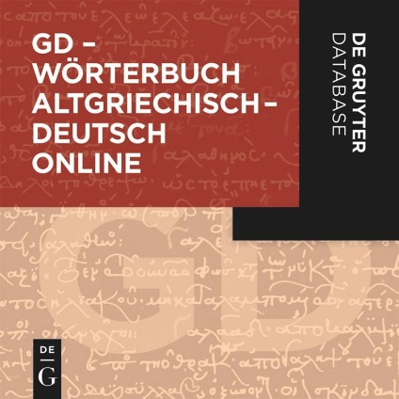
Wörterbuch Altgriechisch-Deutsch Online
The most up-to-date and comprehensive Ancient Greek-German dictionary
Over 140,000 lemmas sourced from literary and documentary texts from the Archaic, Classical, and Hellenistic periods, as well as late antiquity.
Clear presentation of lemmas and a wide selection of examples with precise translations, ideal for Ancient Greek lessons.
Detailed analysis of approx. 15,000 verb forms; presentation of principal parts alongside the respective lemmas.
Approx. 130 schematic summaries of more complex entries.
Full-text search with extensive advanced search options, e.g., by date or place.
Regular updates and additions.
Unlimited number of simultaneous users at every university/institution.
Franco Montanari’s standard reference work GI: Vocabolario della Lingua Greca (3rd ed., Loescher Editore, Turin 2013), the most comprehensive dictionary of Ancient Greek, is finally available in German translation. With its 140,000 entries, the online database GD – Wörterbuch Altgriechisch–Deutsch (Ancient Greek–German Dictionary) edited by Michael Meier-Brügger and Paul Dräger covers the full history of Ancient Greek, from the Archaic to the early Byzantine period, drawing on literary texts as well as papyri and inscriptions as sources. With its user-friendly interface, clear structure and presentation of lemmas, and extensive translation examples, this database is an indispensable tool not just for scholars
but also for teachers and students.
LANGUAGE German
USER INTERFACE English, German
For further information, please visit our website.
Get your free trial here.

Slide 12
De Gruyter Databases 2023 History

Slide 13
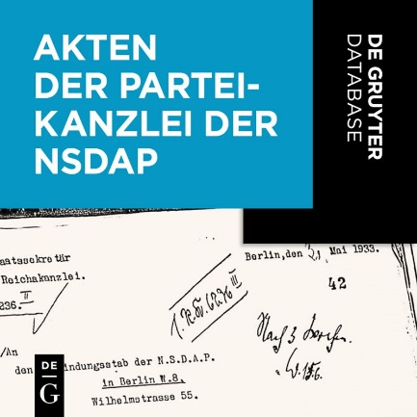
Akten der Partei-Kanzlei der NSDAP
[Records of the Party Chancellery of the National Socialist Party – Reconstruction of Lost Records]
A unique source for the study of the NS system.
The database contains nearly 200,000 pages of 25,842 transactions as digitalized facsimiles.
The database contains (among others historical) supplementary materials.
The Akten der Partei-Kanzlei der NSDAP offer extensive material on the decision-making in all areas of the Nazi regime, from the command system’s inner structure; to the history of legislative regulations in the “Third Reich,” and to state organized measures discriminating against and persecuting Jews, regime critics, and the church; as well as material on the history of one of the most important entities in the Nazi state. In addition, the records contain a variety of details on political personnel.
The written records of this important entity within the Nazi regime were almost completely destroyed at the end of the war. In over 20 years of work the records were reconstructed; it compromises 25,842 transactions with almost 200,000 pages. It contains written correspondence, reports, circulars, directives and decrees, guidelines, statements, letters, entries and other documents. The digitalized facsimiles have been summarized for the edition and provided with descriptive indexes.
Additional material: reference books
Ämter, Abkürzungen, Aktionen des NS-Staates.
Inventar archivalischer Quellen des NS-Staates.
Additional material: reference books from the National Socialist era
Führer durch die Behörden und Organisationen. 1939
Organisationsbuch der NSDAP. 1943
Taschenbuch für Verwaltungsbeamte 1942
LANGUAGE OF PUBLICATION German
USER INTERFACE English, German
SUBJECT AREAS Nationalsocialism; German History; Party History; NS-Crimes
READERSHIP Historians of contemporary history and National Socialism
For further information, please visit our website.
Get your free trial here.

Slide 14
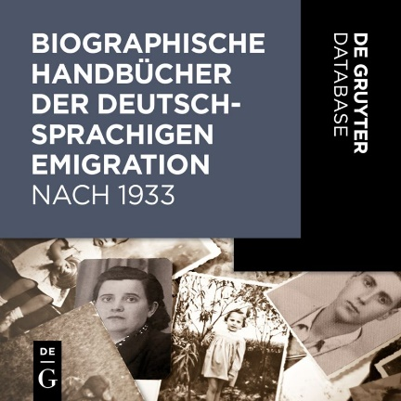
Biographische Handbücher der deutschsprachigen Emigration nach 1933
[Biographical Handbooks of German-speaking Emigrants]
A unique source to study the history of persecution and migration
Combines six sources on the topic in one database
Besides the rich source material the database contains as well further articles and papers as well as links to additional material
The database contains all 8,700 articles on persons of the standard reference work Biographisches Handbuch der deutschsprachigen Emigration nach 1933, which was built up by the Institute for Contemporary History (Institut für Zeitgeschichte) and the Research Foundation for Jewish Immigration, as well as five more sources on that topic. The database allows comprehensive research on the history of migration, persecution, and the influence of emigrants in the countries to which they emigrated.
The database contains the following sources:
Biographisches Handbuch der deutschsprachigen Emigration nach 1933 (International Biographical Dictionary of Central European Émigrés 1933–1945)
Die Ausbürgerung deutscher Staatsangehöriger 1933-45 nach den im Reichsanzeiger veröffentlichten Listen (Expatriation Lists as Published in the “Reichsanzeiger” 1933–45)
Wendland, Ulrike: Biographisches Handbuch deutschsprachiger Kunsthistoriker im Exil. Leben und Werk der unter dem Nationalsozialismus verfolgten und vertriebenen Wissenschaftler (Biographical Dictionary of Emigrated German Art Historians)
Biographisches Handbuch der deutschsprachigen wirtschaftswissenschaftlichen Emigration nach 1933 (Biographical Dictionary of Emigrated German Economists)
Inventar zu den Nachlässen emigrierter deutschsprachiger Wissenschaftler in Archiven und Bibliotheken der Bundesrepublik Deutschland (Inventory of the Archival Deposits of Emigrated German Academics in German Archives and Libraries)
Quellen zur deutschen politischen Emigration 1933–1945. Inventar von Nachlässen, nichtstaatlichen Akten und Sammlungen in Archiven und Bibliotheken der Bundesrepublik Deutschland (Sources on German Political Emigration 1933–1945)
LANGUAGE OF PUBLICATION German
USER INTERFACE English, German
SUBJECT AREAS German History, National Socialism, Migration, Exile
READERSHIP Historians of contemporary history and National Socialism, literary scholars, research institutes
For further information, please visit our website.
Get your free trial here.

Slide 15
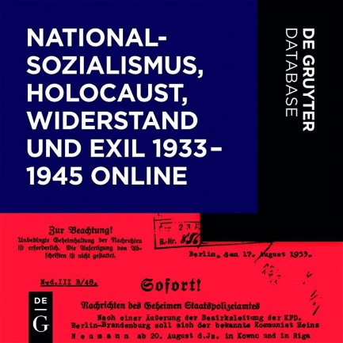
Deutsche Geschichte im 20. Jh.:
Nationalsozialismus, Holocaust, Widerstand und Exil 1933-1945 Online
Approximately 40,000 primary sources with about 450,000 pages.
18,000 biographical articles on perpetrators and victims of the “Third Reich”.
Overviews of the structure and organization of the National Socialist authorities.
Inventories of archival file holdings and estates.
Scholarly introductions to the sources and essays on key themes.
Non-restrictive DRM – allows for unlimited simultaneous users campus / institution-wide.
The database Nationalsozialismus, Holocaust, Widerstand und Exil 1933–1945 Online contains approximately 40,000 primary sources on the National Socialist state and the NSDAP, ideology and propaganda, National Socialist justice system and legislation, on resistance and persecution, and on annihilation and expulsion.
Beyond the primary source editions, the database offers 18,000 biographical articles on perpetrators and victims of the Third Reich.
LANGUAGE German
USER INTERFACE English, German
For further information, please visit our website.
Get your free trial here.

Slide 16
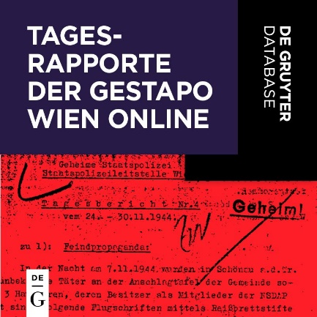
DEUTSCHE GESCHICHTE IM 20. JH.: TAGESRAPPORTE DER GESTAPO WIEN ONLINE
Tagesrapporte der Gestapoleitstelle Wien 1938–1945
Unique source with information on almost 16,000 people (741 daily reports, 5,795 pages).
The Gestapo headquarters in Vienna is the only one whose archive is almost completely preserved.
Previously unpublished, rarely used records on the politically motivated persecution of “public enemies”.
An ideal supplement to the situation and status reports from other parts of the “Reich”.
Offers non-restrictive DRM allowing for unlimited simultaneous users on campus or at an institution.
From 1934 on, the Gestapo Headquarters had to report all incidents to Berlin. These daily reports are a first rate source, barely used until now. Their purpose was to outline the mood, the political situation, and security conditions. The 741 reports
(5,795 pp.) mirror in shocking complexity the focus of political persecution by the Gestapo and thus open the first chapter on the structure of Gestapo persecution, using the example of Vienna.
LANGUAGE German
USER INTERFACE English, German
For further information, please visit our website.
Get your free trial here.

Slide 17
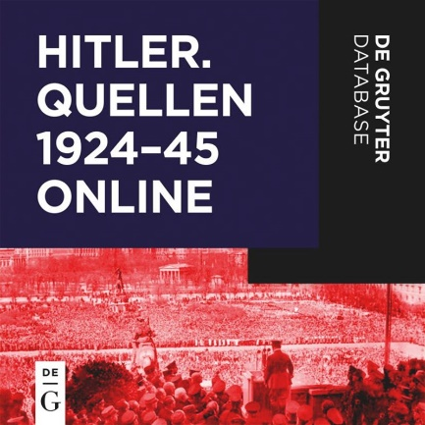
Hitler. Quellen 1924-45 Online
The database contains nearly 9,000 pages of the three original print editions.
Three key sources for Hitler research are now available in a single database that documents the full spectrum of Hitler’s world-view.
Important features: the database can be searched by topic thanks to an integrated subject index; it is also searchable by date, place, name, and publication title.
“What makes the present edition so significant is not least the fact that it documents a critical stage not only in the formation of Hitler’s own thinking
but also in the transformati on of the NSDAP into a Führer movement.” (Ian Kershaw in the Vierteljahrshefte für Zeitgeschichte, commenting on the IfZ edition of “Speeches, Writings, Proclamations”).
Non-restrictive DRM – allows for an unlimited number of simultaneous users campus / institution-wide.
Hitler’s written legacy as contained in the database represents a unique source for studying Hitler’s world-view and his political ambitions. The most important resource for the database is the edition Hitler – Reden, Schriften, Anordnungen (1925–33). In addition, the database contains the more than 1,700 documents from the Max Domarus edition. The source collection is supplemented by documentation
of Hitler’s trial for high treason in 1924.
LANGUAGE German
USER INTERFACE English, German
For further information, please visit our website.
Get your free trial here.

Slide 18
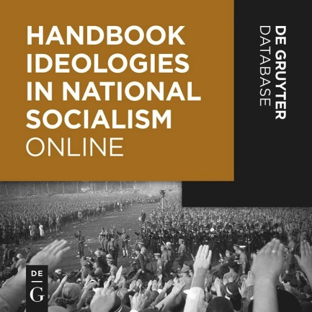
Handbook Ideologies in National Socialism
English language online reference on the ideological aspects of National Socialism which maintained a belief structure underpinning the thoughts and actions of all major and minor players.​
The publication will comprise a series of topics that cover all aspects of National Socialist ideology, embracing the complete spectrum of social activity: from the military to the family household, scholarship in the humanities, sciences, and medicine, as well as covering ecology, racial science, religion and theology, myth and pagan history, symbolism, language, law, and aspects of popular and elite culture.​
Main topics: Persons; Institutions; History of ideas; Terms, Research and Perspectives.​
LANGUAGE German
USER INTERFACE English, German
For further information, please visit our website.
Get your free trial here.

Slide 19
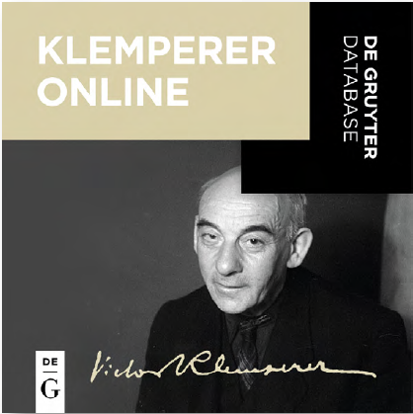
Klemperer Online
The complete diaries with full commentary Each diary entry is also available as a facsimile of the original handwritten entry An intuitive tab structure allows for easy navigation between the transcript and the handwritten original New: the electronic edition of the 1918–1933 and 1945–1959 diaries, more than 4,600 diary entries, with over a third more material than the print editions Total circulation of the printed edition of the diaries 1933–1945: 500,000 copies, with translations in 17 countries Supplements the following databases:
Archiv Bibliographia
Judaica – Deutschsprachiges Judentum Online
Deutsch-jüdische Quellen aus Palästina / Israel
Vossische Zeitung Online
1918–1934 Die Tagebücher von Joseph Goebbels Online as well as Hitler. Quellen 1924–45 Online.
Non-restrictive DRM – allows for an unlimited number of simultaneous users per campus or institution.
For the first time, the database offers the complete and edited diaries of Victor Klemperer, the chronicler of 20th-century German history. From 1918 until 1959, the Romance philologist and converted Jew chronicled the process of disenfranchisement of the Jews and at the same time documented day-to-day life from the Weimar Republic until the early days of the GDR. The digital edition contains transcriptions and facsimiles of the originals.
LANGUAGE German
USER INTERFACE English, German
For further information, please visit our website.
Get your free trial here.

Slide 20
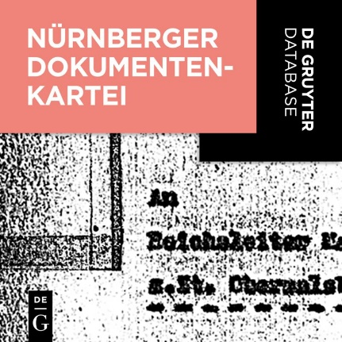
Nürnberger Dokumentenkartei
[Card Index to the Documents of Evidence from the Nuremberg Trials]
The database contains about 200,000 pages of evidence material from the “Nürnberger Prozess”.
Each document is provided with an index of subjects and persons.
For the first time, this card index is available in an easy-to-read, digitalized version.
The trial materials from the main war criminal trials in 1945/46 and the succeeding trials, consisting of over 200,000 pages of evidence, is only accessible for research through this systematic indexing.
In two years of work during the mid-1950s, the “Nuremberg documents” were compiled in cooperation with the then Staatliche Archivlager Göttingen and the Westfälische Wirtschaftsarchiv in Dortmund. Each of the prosecution’s approximately 32,000 evidence documents has been provided with an index-like description and an index of subjects and persons.
The document card index provides access to a wide variety of subject areas and contains among others, descriptions from Western sources of the German economy and finances in the “Third Reich,” of the party organizations, the army, navy and air force, war plans and of the administration in the occupied territories.
LANGUAGE German
USER INTERFACE English, German
For further information, please visit our website.
Get your free trial here.

Slide 21
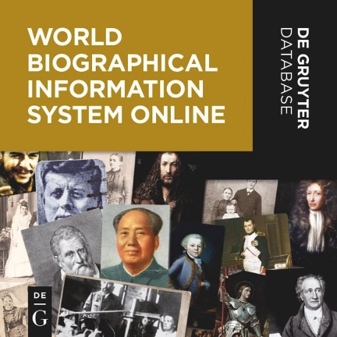
World Biographical Index Online
The world‘s largest digital collection of biographical sources.
An indispensible tool for interdisciplinary research in historical contexts.
Easy access for every library visitor / unlimited digital rights management 29 different archives: regions, cultures and religious groups.
The World Biographical Information System Online (WBIS Online) is the world’s most extensive biographical database, on individuals, families, and groups from all classes and professions, from all
countries and regions of the world, from the 4th millennium BC to the present. The biographical archives on North America, Spain/Portugal/South America, France, Italy, Great Britain, Benelux,
Germany and Russia are constantly updated.
LANGUAGE German
USER INTERFACE English, German
UPDATE FREQUENCY Annually
For further information, please visit our website.
Get your free trial here.

Slide 22
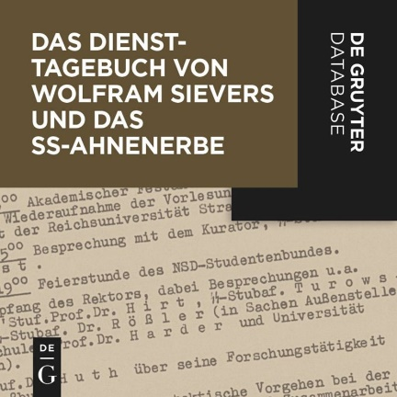
Diensttagebuch Sievers und NS-Ahnenerbe
[The Sievers Diaries and the Nazi Research Network “Ahnenerbe”]
A unique source for the study of the “Ahnenerbe” research network founded by Himmler.
Contains facsimiles and transcripts of the original service diaries with ca. 1,550 entries from 1941–1945.
Allows users to carry out differentiated searches by person, organization, event, place, etc.
Supplements the databases Die Tagebücher von Joseph Goebbels Online and Hitler. Quellen 1924–45 Online.
The database contains Wolfram Sievers’ complete service diaries (1941–1945) and offers a unique source to study the Nazi research network “Ahnenerbe.” This network was founded by Heinrich Himmler. It served from the very beginning to underpin Nazi ideology. At the end of the war, it included dozens of research facilities all over the “German Reich.” The “Ahnenerbe” became well known for its criminal medical experiments and the theft of cultural property. The managing director, Wolfram Sievers, expanded the “Ahnenerbe” network from 1935–1945 and documented all activities in great detail in his service diary. Sievers corresponded with officials of the Nazi regime and with German and international scientists, some of whom only made careers in the Federal Republic and the GDR. This edition of his work diary provides a unique “Who’s who” of German scientific history under National Socialism, which did not end in 1945.
LANGUAGE German
USER INTERFACE English, German
For further information, please visit our website.
Get your free trial here.

Slide 23
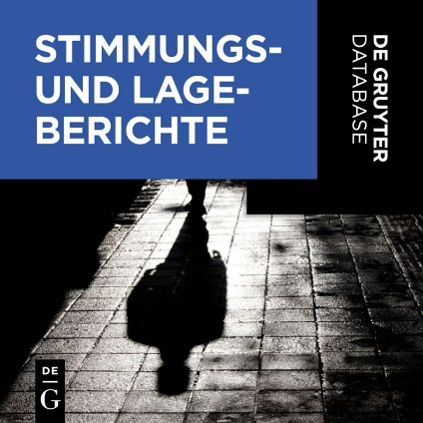
Stimmungs- und Lageberichte
[Secret Reports on Criticism of the Regime, Resistance and Persecution in Germany and the Occupied Areas]
A unique source to study the resistance from a National Socialist perspective.
Combines two sources on the topic in one database.
Besides the rich source material the database contains further articles and papers as well as links to additional material.
Supplements the databases Widerstand als “Hochverrat” and Tarnschriften 1933 bis 1945.
The leaders of the Nazi state were informed regularly of the mood of the population, the activities of regime opponents, and about state organized measures of persecution. The extensive Reports, that combine two sources, are therefore a valuable source for research on resistance from a Nationalsocialist perspective.
With the help of the “German History Portal”, these sources can be searched together with the database Daily Reports of the Gestapo Headquarters Vienna 1938–1945 (Tarnschriften 1933 bis 1945), which also contains reports on the political atmosphere and security conditions.
The database contains the following sources:
Criticism of the Regime, Resistance and Persecution in Germany and the Occupied Areas. Reports from the Geheimes Staatspolizeiamt, SD Hauptamt and Reichssicherheitshauptamt 1933–1945
Reports from the Reich 1938-1945. The secret reports of the SS Sicherheitsdienst
LANGUAGE German
USER INTERFACE English, German
For further information, please visit our website.
Get your free trial here.

Slide 24
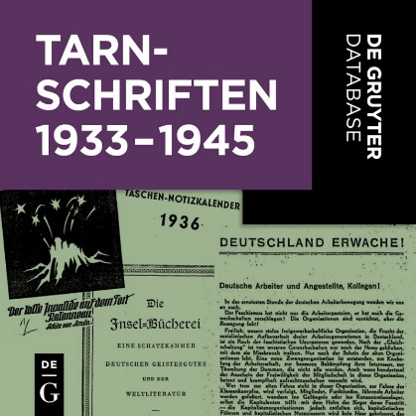
Tarnschriften 1933 bis 1945
An unique source to study the resistance in NS Germany and so-called Grey Literature
The database contains about 1,000 camouflaged writings.
Supplements the databases Stimmungs- und Lageberichte and Widerstand als “Hochverrat”.
The camouflaged texts are digitalized as facsimiles with bibliographical information.
Since censorship and political persecution of the parties and authors prevented the legal publication of opposition ideas, camouflaged texts became a significant part of the resistance after 1933. Anti-regime writings were published and distributed illegally in Germany and Austria from 1933 to the end of the war behind innocuous covers with fictitious details of author, title, publisher, and year and place of publication. Most camouflaged writings originated from the KPD and the SPD, but also emigrated intellectuals and Jews chose to use camouflaged contributions to enlighten the German public about the Nazi dictatorship. Heinz Gittig found about 1,000 camouflaged writings from the years 1933–1945 in European archives and libraries, and created a bibliography of them. The database contains these writings as facsimiles with bibliographical details.
The database is based on the following print and microfiche edition:
Tarnschriften 1933 bis 1945. Editor: K. G. Saur Verlag in collaboration with the Archiv der Parteien und Massenorganisationen der DDR im Bundesarchiv. Mikrofiche-Edition unter Verwendung der Bibliographie der Tarnschriften 1933 bis 1945 von Heinz Gittig. München: K. G. Saur 1997
LANGUAGE German
USER INTERFACE English, German
For further information, please visit our website.
Get your free trial here.

Slide 25
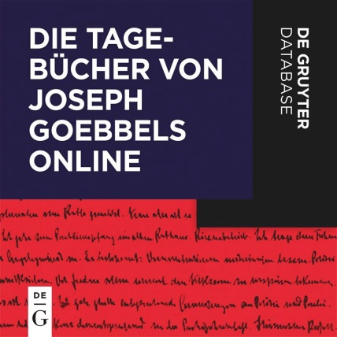
Die Tagebücher von Joseph Goebbels Online
The more than 6,000 diary entries by Joseph Goebbels (approx. 16,800 pages) form an outstanding contemporary source for the years 1923 to 1945.
For the first time the diaries can be searched electronically based on a subject index.
Further features: search by date, place and name.
“A once-in-a-century record of the failure of German idealism and of the triumph of an ideologically based contempt for mankind.” (Elke
Fröhlich).
Non-restrictive DRM – allows for an unlimited number of simultaneous users campus / institution-wide.
The database contains transcriptions of all handwritten documents from 1923 to July 1941, as well as subsequent writings that were dictated up to 1945. This edition is based on the reproduction
of the entire diaries on glass microfiches that was discovered in 1992 by Elke Fröhlich in Moscow. For the first time, the database gives researchers the chance to access the diaries of Joseph Goebbels
electronically using the valuable subject index.
LANGUAGE German
USER INTERFACE English, German
For further information, please visit our website.
Get your free trial here.

Slide 26
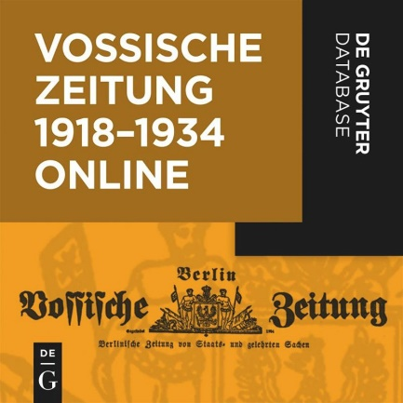
Vossische Zeitung 1918-1934 Online
Excellent source for contemporary and cultural history in high-quality digitization.
New systematic access options to material not previously indexed
Complete collection – illegible pages and missing pages or issues are replaced.
Full text search, navigation via electronic lists of contents, calendar function.
Offers non-restrictive DRM allowing for an unlimited number of simultaneous users on campus or at an institution.
The research database Vossische Zeitung Online. 1918–1934 contains approximately 10,500 issues of the oldest and most renowned Berlin daily newspaper, with a total of some 127,000 full text pages. All issues published from the year 1918 until the newspaper was closed down in 1934, including the supplements, have been arranged and prepared for the online edition, and gaps have been filled.
LANGUAGE German
USER INTERFACE English, German
For further information, please visit our website.
Get your free trial here.

Slide 27
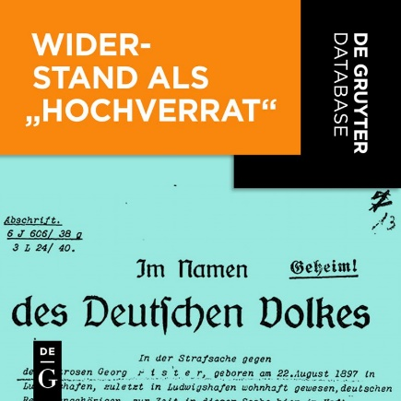
Widerstand als „Hochverrat“
A unique source to study the resistance in NS Germany and the NS judiciary
Combines three sources on the topic in one database
Supplements the databases Stimmungs- und Lageberichte and Tarnschriften 1933 bis 1945
Non-restrictive DRM – allows for an unlimited number of simultaneous users campus- / institution-wide
Political resistance to National Socialism was defined by the judicial system of the “Third Reich” as high treason. Indictments and verdicts of cases brought before the various central courts are therefore an important source of information on the history of the German resistance. The database combines indictments and cases brought before the Reichsgericht, Volksgerichtshof, Reichskriegsgericht, and trails against Austrians in Vienna and Graz. Additionally, the database contains the political writing and letters of Carl Friedrich Goerdeler.
LANGUAGE German
USER INTERFACE English, German
For further information, please visit our website.
Get your free trial here.

Slide 28
De Gruyter Databases 2023 Jewish Studies

Slide 29
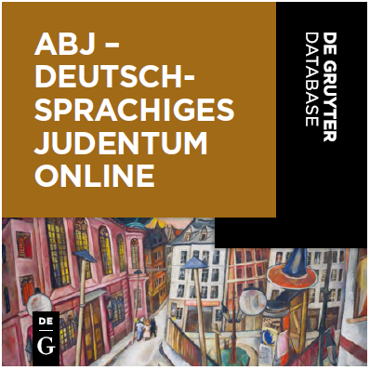
ABJ– DEUTSCHSPRACHIGES JUDENTUM ONLINE Bio-bibliographische Sammlung, 18.–20. Jh.
[Archiv Bibliographia Judaica – German Jewry Online: Biobibliographical collection, 18th to the 20th centuries]
An indispensable research tool for anyone working on German-Jewish history and culture.
An impressive archive of German-speaking Judaism and its written heritage.
Biographical data on more than 15,000 German-Jewish figures from all areas and walks of life (5,000 entries will be added in 2022), including links to bibliographical information on 250,000 scanned index cards.
Contains the complete 21-volume Lexikon deutsch-jüdischer Autoren (Encyclopedia of German-Jewish Authors) including extensive biographical information on 1,300 selected authors.
Includes figures from the 18th to 20th centuries with a focus on the late 19th century/first half of the 20th century.
Supplements the Deutsch-jüdische Quellen aus Palästina/Israel (German-Jewish Sources from Palestine/Israel), Vossische Zeitung Online. 1918–1934 and Klemperer Online. Tagebücher 1918–1959 databases.
Non-restrictive DRM – allows for unlimited simultaneous users campus / institution-wide. This unique database assembles a large number of important documents on the German-Jewish tradition from the Bibliographia Judaica Archive in Frankfurt am Main. It allows targeted searches of biographical details of over 20,000 individuals with links to scanned index cards containing related bibliographical data. The collection includes writers, politicians, rabbis, and different intellectuals.
LANGUAGE OF PUBLICATION German
USER INTERFACE German, English
SUBJECT AREAS German-Jewish History; Modern
Jewish Literature
READERSHIP Academics interested in German-
Jewish history and culture, e.g. scholars of German
Studies, History and Theology, Rabbis
For further information, please visit our website.
Get your free trial here.

Slide 30
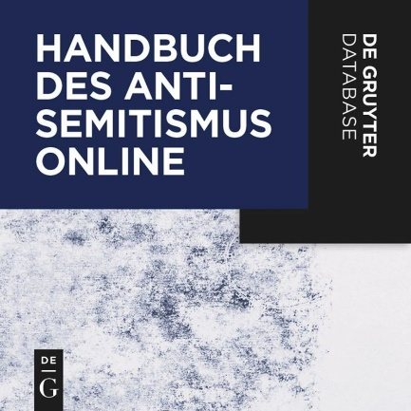
Handbuch des Antisemitismus Online
Published by the renowned Center for Research on Antisemitism (Zentrum für Antisemitismusforschung, Berlin).
More than 2,200 entries in seven subject areas of the Handbook.
Subject-specific search and browsing functions, including people, places, terms, etc.
Supplements the following databases: Klemperer Online. Tagebücher 1918–1959, the Singerman Bibliography of Antisemitic Texts in English, Die Tagebücher von Joseph Goebbels Online und Hitler. Quellen 1924–45 Online.
Non-restrictive DRM – allows for an unlimited number of simultaneous users per campus or institution.
The Handbuch des Antisemitismus Online compiles the existing knowledge on antisemitism: this database contains all of the over 2,200 entries from the eight-volume Handbuch (2008–2015) and also provides users with new research functions. Its objective is to make knowledge about antisemitism accessible to anybody in academia or schools, media or politics who requires information about
prejudice against and stereotypes about Jews.
LANGUAGE German
USER INTERFACE English, German
For further information, please visit our website.
Get your free trial here.

Slide 31
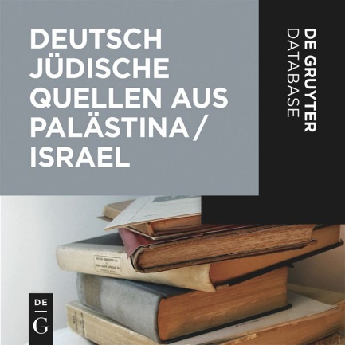
Deutsch-jüdische Quellen aus Palästina / Israel
Bibliographie und ausgewählte Originalwerke (1890–2000)
Top resource for everybody studying German-Jewish literature, history and culture, but also for students of the history of Zionism and Israel.
Ca. 1,500 bibliographic entries, of which ca. 250 of the most relevant and rare titles are linked to the original source in full text (ca. 25,000 pages).
The unique collection represents the cultural and intellectual realm of the German-speaking world in Israel/Palestine.
Texts by Schalom Ben-Chorin, David Ben-Gurion, Chajim Nachman Bialik, Max Brod, Constantin Brunner, Sammy Gronemann, Theodor Herzl, Georg Landauer and Else Lasker-Schüler
Rare texts that document the political development and everyday life of Palestine / Israel.
Thematic search.
Non-restrictive DRM – allows for an unlimited number of simultaneous users campus / institution-wide.
Palestine, and later Israel, has been of foremost importance for German-Jewish immigration. Famous texts by major writers, including Else Lasker-Schüler, Sammy Groneman and Shalom Ben-Chorin, were published in Palestine, not in Germany. The electronic resource contains writings of all genres which can be searched by category (e.g. history). The bibliography records approximately 1,500 entries, of which approx. 250 are linked to their full texts.
LANGUAGE German
USER INTERFACE English, German
For further information, please visit our website.
Get your free trial here.

Slide 32
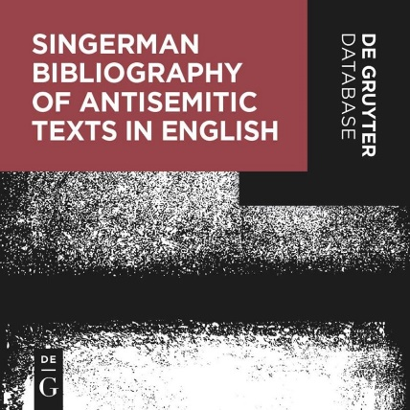
Singerman Bibliography of Antisemitic Texts in English
More than 9,200 entries of English antisemitic publications, accompanied by
short summaries.
Important tool for researchers to find the original texts to study the phenomenon
of antisemitism.
Indispensable guide to primary sources.
Selection of relevant antisemitic texts, chosen by the long-term expert in the field
and the most prominent bibliographer of Judaica, Robert Singerman.
The database identifies owning libraries and repositories.
Search categories: author, title, publication year.
Supplements the following databases: Klemperer Online, Die Tagebücher von
Joseph Goebbels Online, Hitler. Quellen 1924 – 45 Online, and Handbuch des
Antisemitismus Online
Unlimited number of simultaneous users per campus or institution.
The academic study of modern antisemitism and Judeophobia requires a thorough analysis of primary sources across multiple languages, genres, and formats. This bibliographic database identifies a significant variety of books, pamphlets, ephemera, and selected articles, either written in English or translated into English, from the beginning of the 19th century extending to 2015 imprints. The sources come from different countries around the world and the texts reflect a wide diversity of religious, extremist, and nationalist ideologies. A large percentage of the more
than 9,200 texts are blatant hate propaganda and theologically driven, while others are considerably more subtle in tone. A unique feature of this bibliography are the descriptive annotations, often with quotes from cited sources, and the identification of owning libraries and repositories where copies are located. The bibliography can be searched by author, title, and publication year.
LANGUAGE German
USER INTERFACE English, German
For further information, please visit our website.
Get your free trial here.

Slide 33
De Gruyter Databases 2023 Linguistics and Semiotics

Slide 34
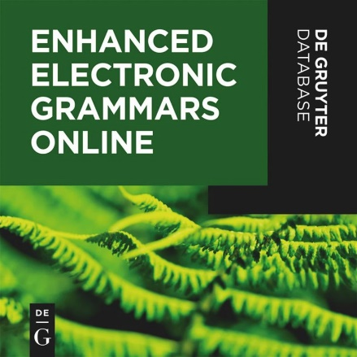
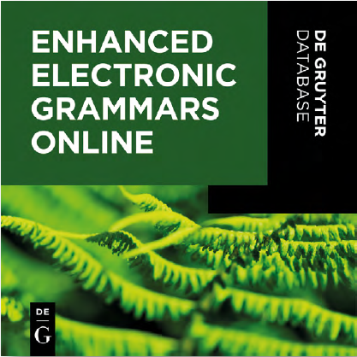
Enhanced Electronic Grammars Online
An advanced research tool for linguists
A sophisticated online reference work specially designed for the needs of general linguists and typologists.
Enables simultaneous search across dozens of languages on hundreds of linguistic phenomena.
Makes complex multiple searches possible.
Each linguistic phenomenon is illustrated by examples with interlinear glossing and free translations.
Focus on small and endangered languages stimulates new insights on human language
Non-restrictive DRM – allows for an unlimited number of simultaneous users campus / institution-wide.
Enhanced Electronic Grammars (EEG) features comprehensive descriptions of languages from around the world. Through this unique online reference work, full grammars are made available together in an interlinked and semantically-annotated
format, allowing granular access to the grammatical data and enabling cross-language research of several grammars at the same time.
LANGUAGE German
USER INTERFACE English, German
UPDATE FREQUENCY Twice a year
For further information, please visit our website.
Get your free trial here.

Slide 35
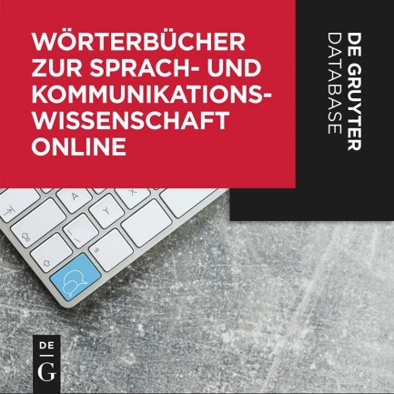
Wörterbücher zur Sprach- und Kommunikationswissenschaft (WSK) Online
A modern lexicographic online database with more than 14,000 articles.
Annual updates with 3,000 articles.
Written by respected, international scholars.
Bilingual user interface with numerous search criteria.
Non-restrictive DRM – allows for an unlimited number of simultaneous users campus / institution-wide.
WSK Online is a comprehensive lexicographic dictionary that covers all the major areas of linguistics and communication science. The articles are in German (with English translations of the terms and
definitions) or in English (with German translations of the terms and definitions).
LANGUAGE German
USER INTERFACE English, German
UPDATE FREQUENCY Twice a year
For further information, please visit our website.
Get your free trial here.

Slide 36
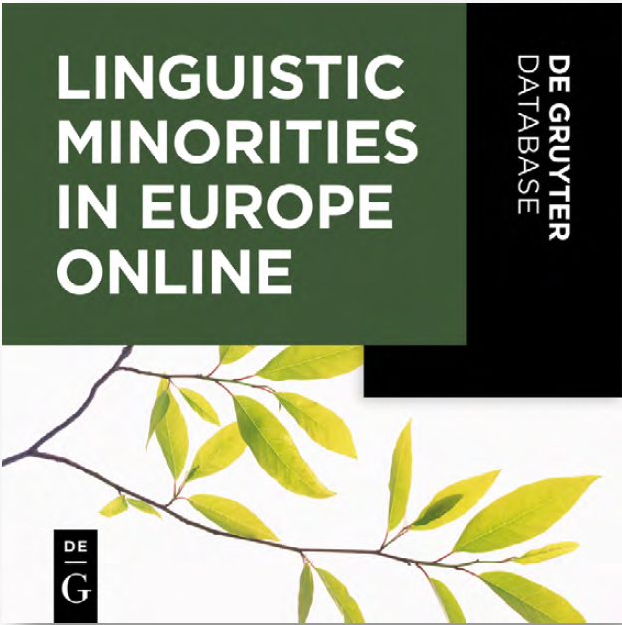
Linguistic Minorities in Europe Online
A Born-Digital, Multimodal, Peer-Reviewed Online Publication
Interdisciplinary approach to the investigation of linguistic minorities in Europe.
Standardized overview articles as well as in-depth research articles.
Multimedia elements (audio files, videos, images).
Publication of primary sources (OA and non-OA is possible).
Differentiated search functions on the basis of extensive metadata of all LME entries.
Comprehensive interlinking of content (also with external sources)
New articles in two updates every year.
Non-restrictive DRM – allows for an unlimited number of simultaneous users campus- / institution-wide.
LME Online provides comprehensive documentation of indigenous and immigrant linguistic minorities in Europe. It contains standardized overview articles on minority languages and in-depth research articles on more specific topics. Many articles include multimedia elements.
LME is open for publishing complete primary sources, such as annotated texts, transcriptions, glossaries, corpora or field notes (OA as well as non-OA).
LANGUAGE German
USER INTERFACE English, German
UPDATE FREQUENCY Twice a year
For further information, please visit our website.
Get your free trial here.

Slide 37
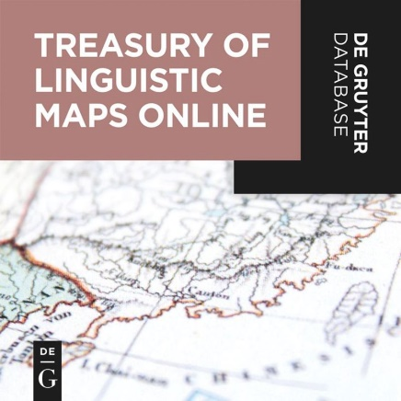
Treasury of Linguistic Maps Online
High-resolution linguistic maps from De Gruyter’s archives, some of them presented for the first time in digital format.
Enriched with detailed metadata allowing specific searches.
Map interface allows zooming, printing, and PDF export
Maps in English and German, all metadata in English for comprehensive searches (completion in 2022).
Completion of content in 2022, containing 8,000 maps.
Non-restrictive DRM – allows for an unlimited number of simultaneous users campus- / institution-wide.
Treasury of Linguistic Maps, an indispensable resource for visualized information on various topics in linguistics, presents linguistic maps selected from various atlases and other publications that have been published by De Gruyter/De Gruyter Mouton. For the first time, this material is made searchable in one place and in a new, improved format. All maps have been scanned in high-resolution for maximum quality and enriched with detailed metadata.
LANGUAGE German
USER INTERFACE English, German
For further information, please visit our website.
Get your free trial here.

Slide 38
De Gruyter Databases 2023 Literary Studies

Slide 39
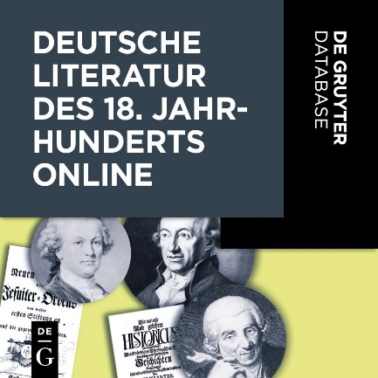
Deutsche Literatur des 18. Jahrhunderts Online
Erstausgaben und Werkausgaben von der Frühaufklärung bis zur Spätaufklärung
First editions and first published complete editions by German-language authors of the 18th century.
Each work is available as a digital facsimile; searchable in full text.
Electronic tables of contents that allow direct access to the start of each chapter.
Each work is classified by one or more literary genres, enabling systematic access to the contents of the database.
Non-restrictive DRM allows for an unlimited number of simultaneous users on campus / institution-wide
Through 18th Century German Literature Online, first editions and first published complete editions by 642 German-speaking authors of the 18th century are now available online. The 2,675 works with 4,494 volumes reflect the broad spectrum of
German literature from the early stages of the age of Enlightenment to the later part of the period.
LANGUAGE German
USER INTERFACE English, German
For further information, please visit our website.
Get your free trial here.

Slide 40
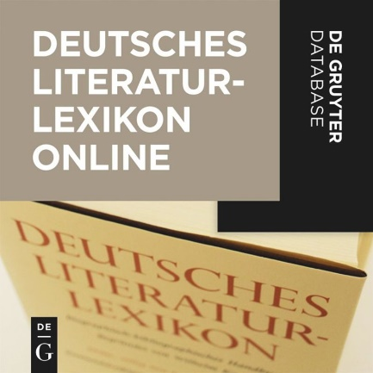
Deutsches Literatur-Lexikon Online
Offers comprehensive and reliable information on authors from German-speaking countries, from the Middle Ages to the present.
Integration with the Verfasser-Datenbank (Database of Authors): articles refer to the Verfasser-Datenbank via links.
Search options include keywords, names, work titles, genres, biographical data, contributors and literature references.
Citability is ensured thanks to a DOI for each article
Bibliographic information is updated on a continuous basis with data from the Germanistik Online Database
The online reference work’s non-restrictive DRM allows for an unlimited number of simultaneous users at each campus/institution
This online reference work makes the most well-known and reliable texts on German literature available for the first time online: Deutsches Literatur-Lexikon and its supplemental series, Deutsches Literatur-Lexikon. Das 20. Jahrhundert and Deutsches Literatur Lexikon. Das Mittelalter. Initially, the online reference work contains 77 volumes with some 70,000 articles. Two volumes will be added each year.
LANGUAGE German
USER INTERFACE English, German
UPDATE FREQUENCY Twice a year
For further information, please visit our website.
Get your free trial here.

Slide 41
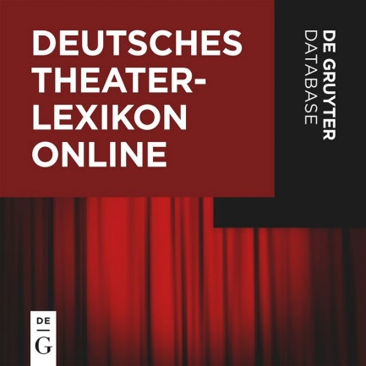
Deutsches Theater-Lexikon Online
Biographisches und bibliographisches Handbuch
The only comprehensive bio-bibliographic encyclopedia of the world of theatre in the German speaking world.
Contains information on every aspect of the stage
Search options include people, biographical information, professions and literature.
The online reference work’s non-restrictive DRM allows for an unlimited number of simultaneous users at each campus/institution.
This online reference work brings together all of the volumes of the Deutsches Theater-Lexikon [Encyclopedia of German Theatre] as an online database. It provides a host of information on every aspect of the stage and comprises meticulous research on performers, directors, playwrights, playhouses etc. The database defines significant key words and organizational structures and offers
advanced search functions.
LANGUAGE German
USER INTERFACE English, German
For further information, please visit our website.
Get your free trial here.

Slide 42
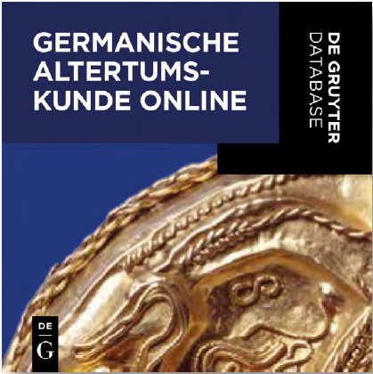
Germanische Altertumskunde Online
Kulturgeschichte bis ins Frühmittelalter - Archäologie, Geschichte, Philologie
An authoritative online reference work covering all areas of early Germanic history.
Approx. 15 new and revised articles and 5 volumes are published each year.
Non-restrictive DRM – allows for an unlimited number of simultaneous users campus / institution-wide.
Germanische Altertumskunde Online (GAO) provides a unique research platform representing the current state of knowledge of Germanic and Northern European cultural history (subject areas history, archeology, art history, legal history, ethnology, and
religious studies). It contains the Reallexikon der Germanischen Altertumskunde, new and revised articles, the RGA-E series (currently, more than 120 volumes), journal articles, and single books.
LANGUAGE German
USER INTERFACE English, German
UPDATE FREQUENCY Twice a year
For further information, please visit our website.
Get your free trial here.

Slide 43
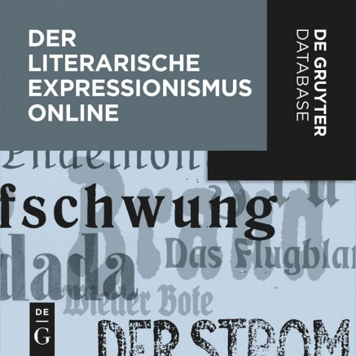
Der literarische Expressionismus Online
Zeitschriften, Jahrbücher, Sammelwerke, Anthologien
151 journals, yearbooks, collections, and anthologies from the early 20th century.
2,404 issues in full text.
Journals, yearbooks, collections, and anthologies are presented online as digital facsimiles.
Articles can be found through various search criteria, including full text search.
Supplemented with bio-bibliographical articles on 350 expressionist authors.
Non-restrictive DRM – allows for an unlimited number of simultaneous users campus / institution-wide.
Through the research database Der Literarische Expressionismus Online (German Literary Expressionism Online) 151 journals, yearbooks, collections and anthologies from the early 20th century
with 2,404 issues are now available in full text.
LANGUAGE German
USER INTERFACE English, German
For further information, please visit our website.
Get your free trial here.

Slide 44
De Gruyter Databases 2023 Medicine

Slide 45
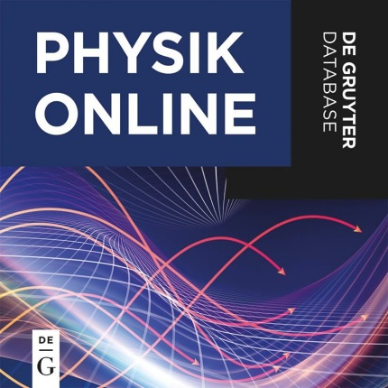
PHYSIK ONLINE
[Physics Online]
Covering the whole curriculum of physics.
Quick and comprehensive information on more than 100 subjects with extended lists for further reading including annual updates.
Swift results due to detailed thesaurus with 20,000 keywords.
Special highlighted content like Examples, Exercise/Solution, Consider, Learning Target, and Summary.
For undergraduate and graduate students with a major and minor in physics, PhD students, and lecturers.
Non-restrictive DRM – allows for an unlimited number of simultaneous users campus / institution-wide.
Physik Online offers detailed lectures on the entire curriculum of physics, from elementary foundations to further specialized fields. Excellent linking within the topics on the one hand, and the targeted
selection of specific texts such as mnemotechnic verses, learning objectives, and summaries on the other make this online reference work a valuable collection.
LANGUAGE German
USER INTERFACE English, German
UPDATE FREQUENCY Annually
For further information, please visit our website.
Get your free trial here.

Slide 46
De Gruyter Databases 2023 Philosophy

Slide 47
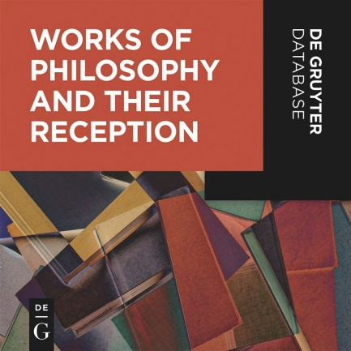
Works of Philosophy and Their Reception
Approximately 40,000 primary sources with about 450,000 pages.
18,000 biographical articles on perpetrators and victims of the “Third Reich”.
Overviews of the structure and organization of the National Socialist authorities.
Inventories of archival file holdings and estates.
Scholarly introductions to the sources and essays on key themes
Non-restrictive DRM – allows for an unlimited number of simultaneous users campus / institution-wide.
The database Nationalsozialismus, Holocaust, Widerstand und Exil 1933–1945 Online contains approximately 40,000 primary sources on the National Socialist state and the NSDAP, ideology and propaganda, National Socialist justice system and legislation, on resistance and persecution, and on annihilation and expulsion.
Beyond the primary source editions, the database offers 18,000 biographical articles on perpetrators and victims of the Third Reich.
LANGUAGE German
USER INTERFACE English, German
For further information, please visit our website.
Get your free trial here.

Slide 48
De Gruyter Databases 2023 Theology and Religious Studies

Slide 49
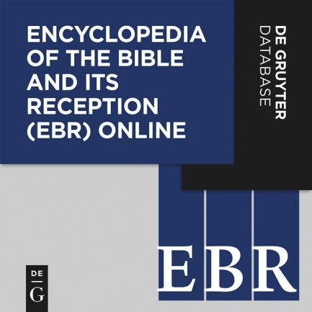
Encyclopedia of the Bible and Its Reception Online
CHOICE Outstanding Academic Title 2020: The database has been recognized with this award due to the excellence of its scholarship and presentation and for its great significance to its field of research.
The online reference work
Contains Hebrew Bible/Old Testament, New Testament, and historical contexts.
Spans biblical reception in Judaism, Christianity, Islam, and other religions as well as in literature, visual arts, music, and film.
Provides approx. 1,500 new articles per year
Offers non-restrictive DRM allowing for an unlimited number of simultaneous users on campus or at an institution.
The Encyclopedia of the Bible and Its Reception (EBR) Online serves as a comprehensive guide to the current state of knowledge on the background, origins, and development of the texts of the Bible.
Unprecedented in breadth and scope, this encyclopedia also documents the history of the Bible’s interpretation and reception, not only in Judaism and Christianity, as well as in Islam and other religious traditions, but also in literature, visual art, music, film, and dance.
LANGUAGE German
USER INTERFACE English, German
UPDATE FREQUENCY Four times a year
For further information, please visit our website.
Get your free trial here.

Slide 50
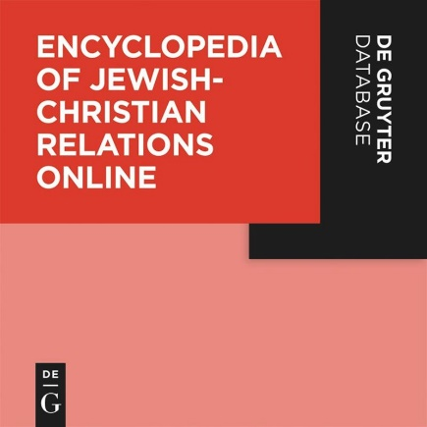
Encyclopedia of Jewish-Christian Relations Online
Foundational work in 200 entries: 2,000 years of Jewish-Christian interaction.
Updated twice per year.
Joint perspectives and new avenues for the future.
Target readership: Scholars, academics, and students.
EJCR will be also available in a print version.
The database provides an overview of Jewish-Christian interaction over the centuries up until today, and thus establishes a standard reference work of interdisciplinary research. International experts at the cutting edge of their disciplines will investigate in two hundred entries more than two thousand years of Jewish-Christian interaction, assess the achievements of dialogue and provide joint perspectives and new avenues for the future.
LANGUAGE German
USER INTERFACE English, German
UPDATE FREQUENCY Twice a year
For further information, please visit our website.
Get your free trial here.

Slide 51
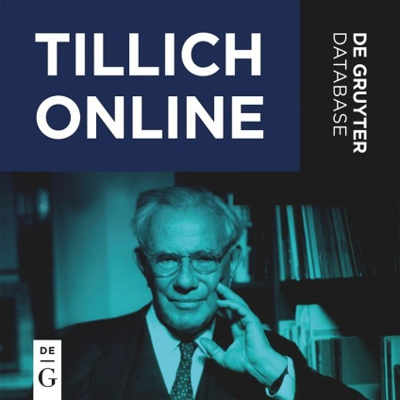
Tillich Online
Werke deutsch-englisch / Works German-English
An indispensable research tool for anyone interested in Paul Tillich’s work.
Completely documents the Gesammelte Werke (Collected Works) and the Ergänzungs- und Nachlassbände (Supplementary and Literary Estate Volumes).
Offers full text search with extensive advanced search options.
English-language content is being updated annually.
The editors aim to assemble a complete bilingual edition of Tillich’s work.
Non-restrictive DRM – allows for an unlimited number of simultaneous users campus / institution-wide.
Tillich Online is the first bilingual database to make the entire work of the important German-American theologian Paul Tillich (1886–1965) electronically accessible. In addition to Tillich’s extensive German-language oeuvre, users can access original
English material authored by Tillich, as well as translations from the German, which are gradually being added to the database.
LANGUAGE German
USER INTERFACE English, German
UPDATE FREQUENCY Annually
For further information, please visit our website.
Get your free trial here.

